Slide 1
Whole-school Approach for Youth with migrant background
WAY
Dissemination & Communication Update
Dr. Sidiropoulos Dimitrios - email: dsidir@gmail.com

Slide 2
Agenda First Transnational meeting Valladolid, 20-21 October 2021
Main Points
Logo Creation
Dissemination Strategy
Facebook page & Social Media
Website
SEO (Search Engine Optimization)

Slide 3
WAY Logo
Important
Logo already redesigned
Meaning - Slogan
Whatever color you have (different colors at earth image), wherever you come from (earth image), WAY is a program to help
Tips:
- Avoid changing the proportions (length and width);
- Meant to be used on neutral background(preferably white).

Slide 4
Dissemination Strategy
Design of the Logo
Social Media Accounts
Build the website
Design the logo of the project to use it on every official project document
Create a FB page to share articles and information. Publicity of the project
Publish results, events, activities, mobilities, training, material, photos, etc.

Slide 5
Facebook – Social Media
Regular Posts (each week or two posts per month)
Use of the project logo
Share content of the website (blog, articles, photos, etc.)
Share & Re-post from the partners, Like & Comments
Invite friends to like the project FB page
FB ads (if needed)
FB page address : https://www.facebook.com/erasmus.ka2.way.project

Slide 6
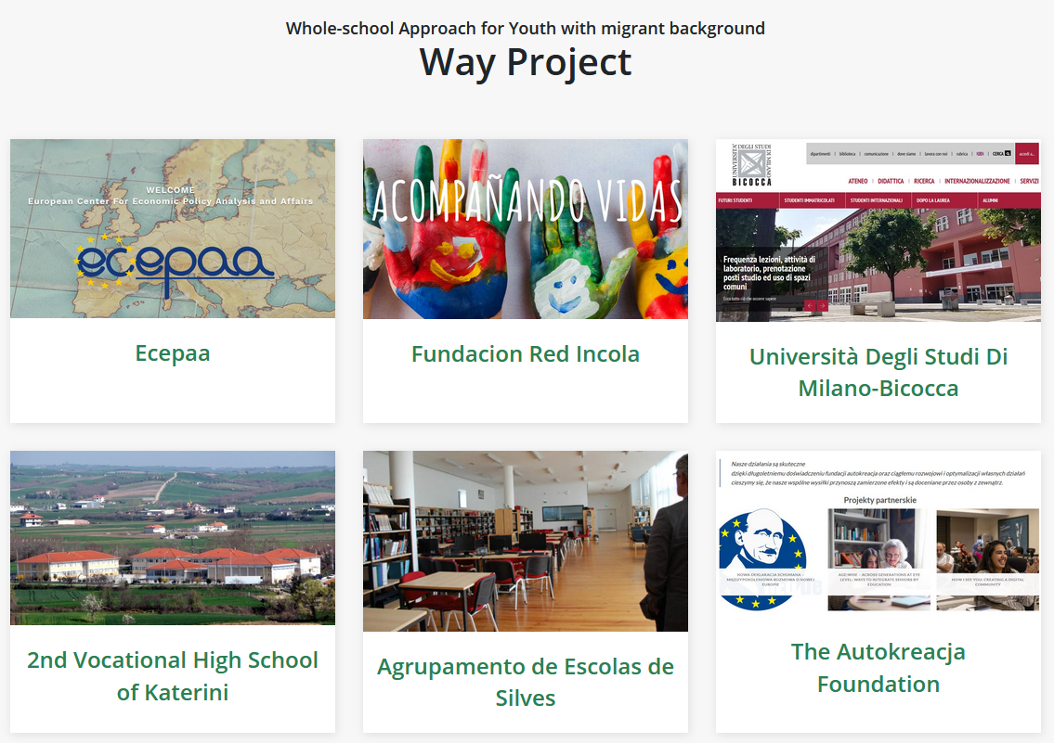
Website : way-project.eu
Contents:
English Language
Description of the project and the partners
Articles concerning the project and research
Photos of the meetings
Results of the project
upcoming events

Slide 7
Website SEO (to do)
Google friendly pages
Sitemap
Keywords, Meta-descriptions
Google Webmaster account
Google Analytics
Website submission on search engines, blogs, forums, other pages

Slide 8
Next step for all partners
Display on your website a description of the project and a banner linked to the WAY website and FB page
Share on your Facebook page every content, and maybe translating it into your own language
Define a person to be in charge of sharing contents from the WAY FB page, or of creating original contents related to the project and share it

Slide 9
Tags to use
Ecepaa @Ecepaa
Fundacion Red Incola @redincola
The 2nd Vocational High School of Katerini @2epal.katerinis
I.I.S Laeng Meucci @iisLaengMeucci
Agrupamento de Escolas de Silves @secundaria.silves
The Autokreacja Foundation @annalindhfoundation
Università Degli Studi Di Milano-Bicocca @bicocca

