Slide 1
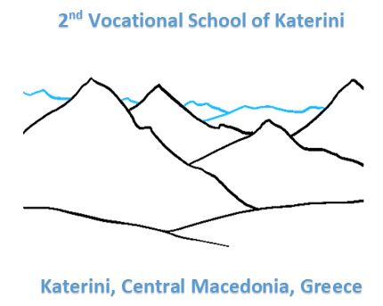
IHAVET+ Questionnaire Results for Parents
Random Sample on 2nd Vocational School of Katerini

Slide 2
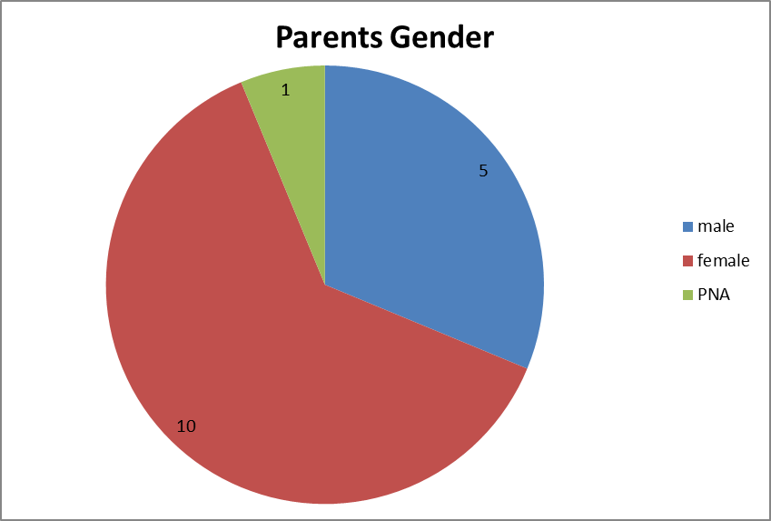
PARENTS GENDER

Slide 3
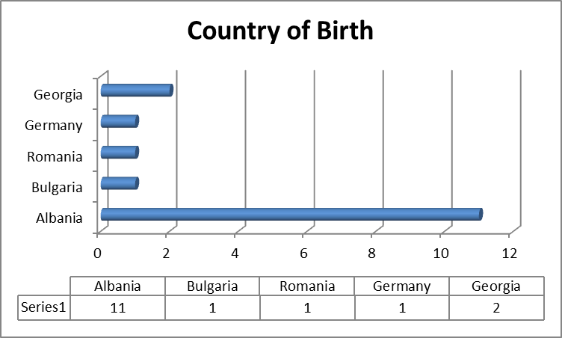
PARENTS COUNTRY OF BIRTH

Slide 4
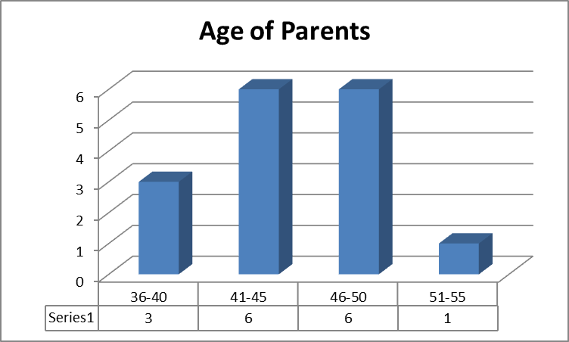
PARENTS AGE

Slide 5
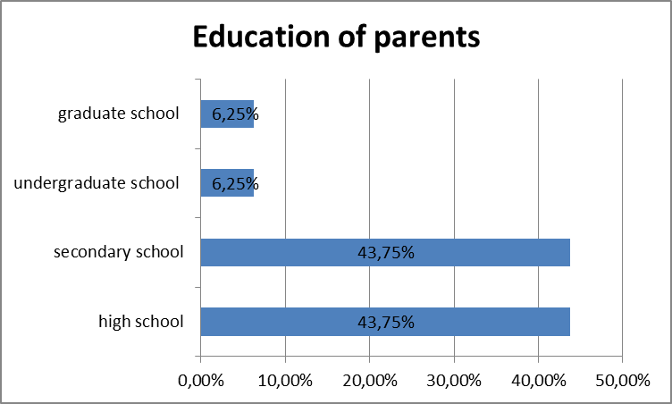
PARENTS EDUCAtion

Slide 6
PARENTS EDUCAtion

Slide 7
More results
94% of the parents have a job either part time or full time
Most of them work on an unskilled work
40% of the parents have some problems with the language, either on speaking, writing or even reading
Only half of them know the student’s teachers
Less than 20% participate on the elections of the collegiate bodies
Half of the parents answered that teacher is person to be respected
More than 50% answered that they want their kid to go to University
About 60% of them answered that they want to change something to the education
over 70% answered that the education system provides adequate skills for the labor market

Slide 8
IHAVET+ Questionnaire Results for students
Random Sample on 2nd Vocational School of Katerini

Slide 9
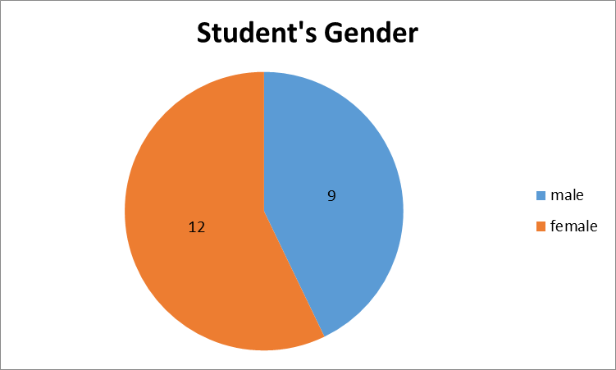
Student’s GENDER

Slide 10
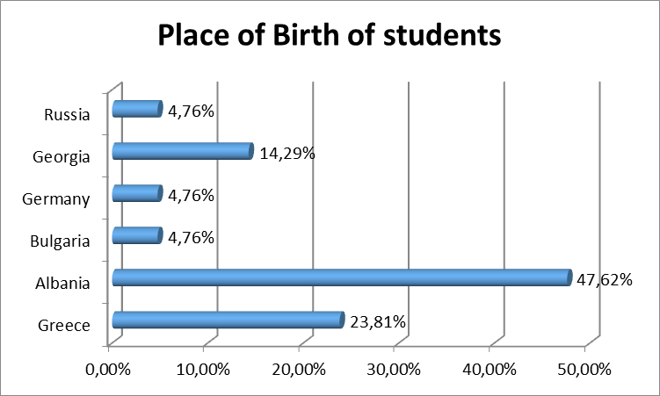
Student’s COUNTRY OF BIRTH

Slide 11
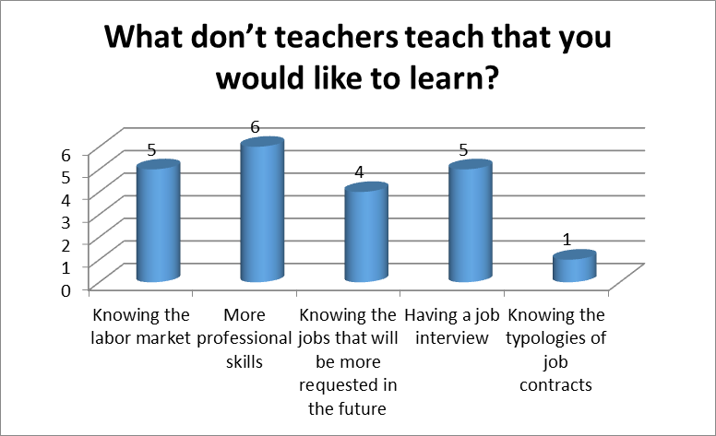
What would you like to learn more

Slide 12
PARENTS EDUCAtion

Slide 13
More results
All the students (100%) come to the school by bus
About 80% of the students believe that that have a normal relationship with their teachers
23% got sometime a conflict with a teacher because of his/her attitude
Half of the students (52%) answered that sometime they have been bullied
Around 70% of the students replied that they want to change something at the education system
All of the students (100%) answered that they stay with their family
About 20% of the students don’t stay with both their parents
About 90% of the students answered that they choose their school together with their parents

Slide 14
IHAVET+ Questionnaire Results for teachers
Random Sample on 2nd Vocational School of Katerini

Slide 15
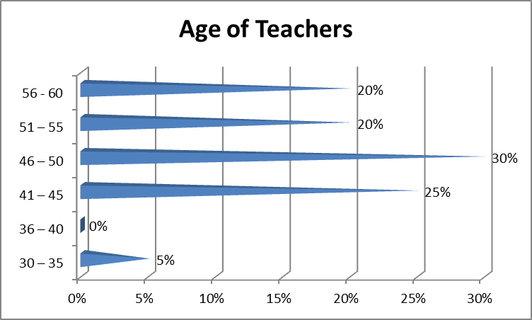
Teacher’s age

Slide 16
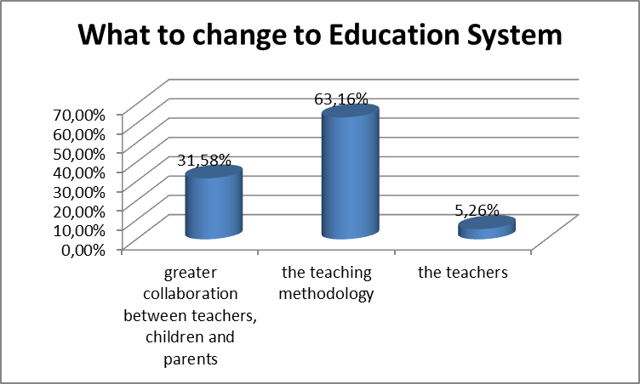
95% want to change something What to change ?

Slide 17
More results
About 60% of the teachers have no specific skills in order to teach students with migrant background
Almost all of the teachers (except one) answered that take into consideration past experiences and/or skills of the children
Concerning the difficulties that immigrant students have, most of the teachers answered that the problems are related to the language.
90% of the teachers answered that migrant children integrated into the class
80% of the teachers answered that the relationship with parents of students with migrant background is scarce
95% of the teachers answered that they update the parents about the goals achieved by their children

